Slide 1
Web Project

Slide 2
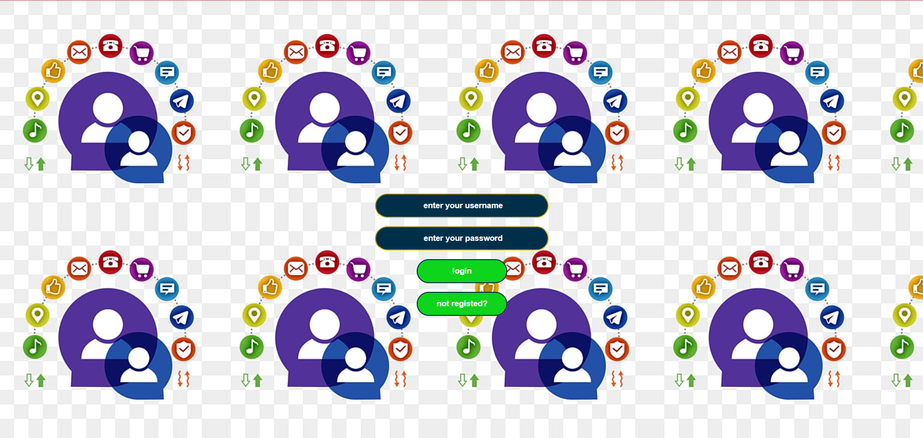
The login of the website

Slide 3
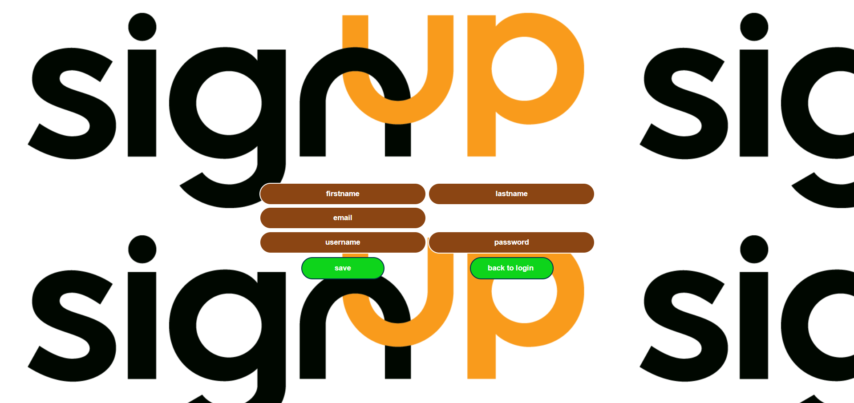
Register for the website

Slide 4
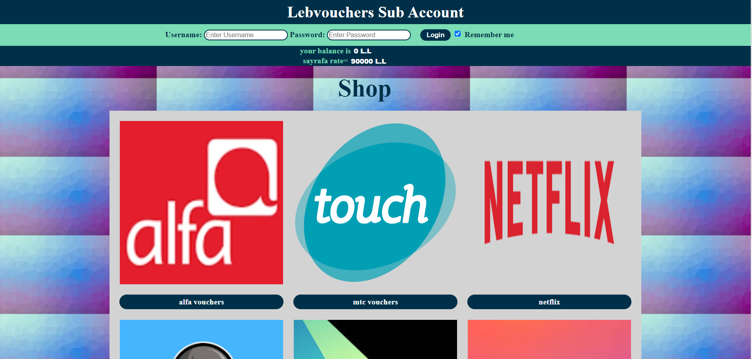
This is the main page which is the index page
the user can log in using their username and password and checking their balance
Or the user can browse the available vouchers and sayrafa rate

Slide 5

If log in is successful the user can see his own balance

Slide 6
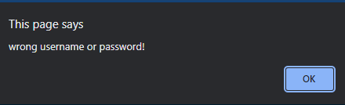
If logging in is failed, a pop up will show

Slide 7
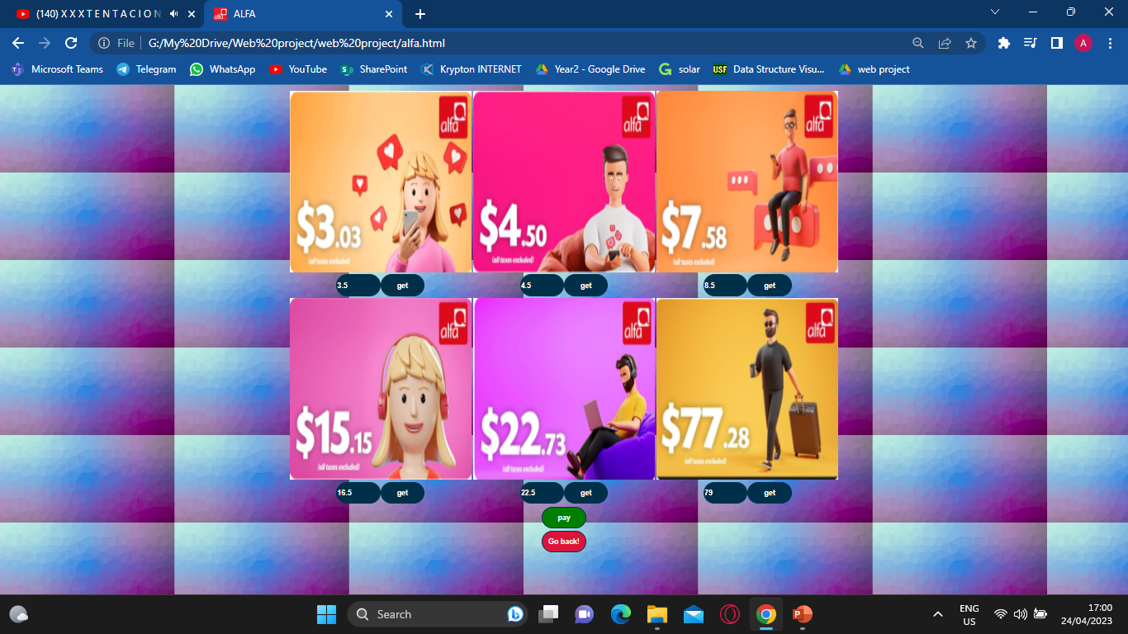
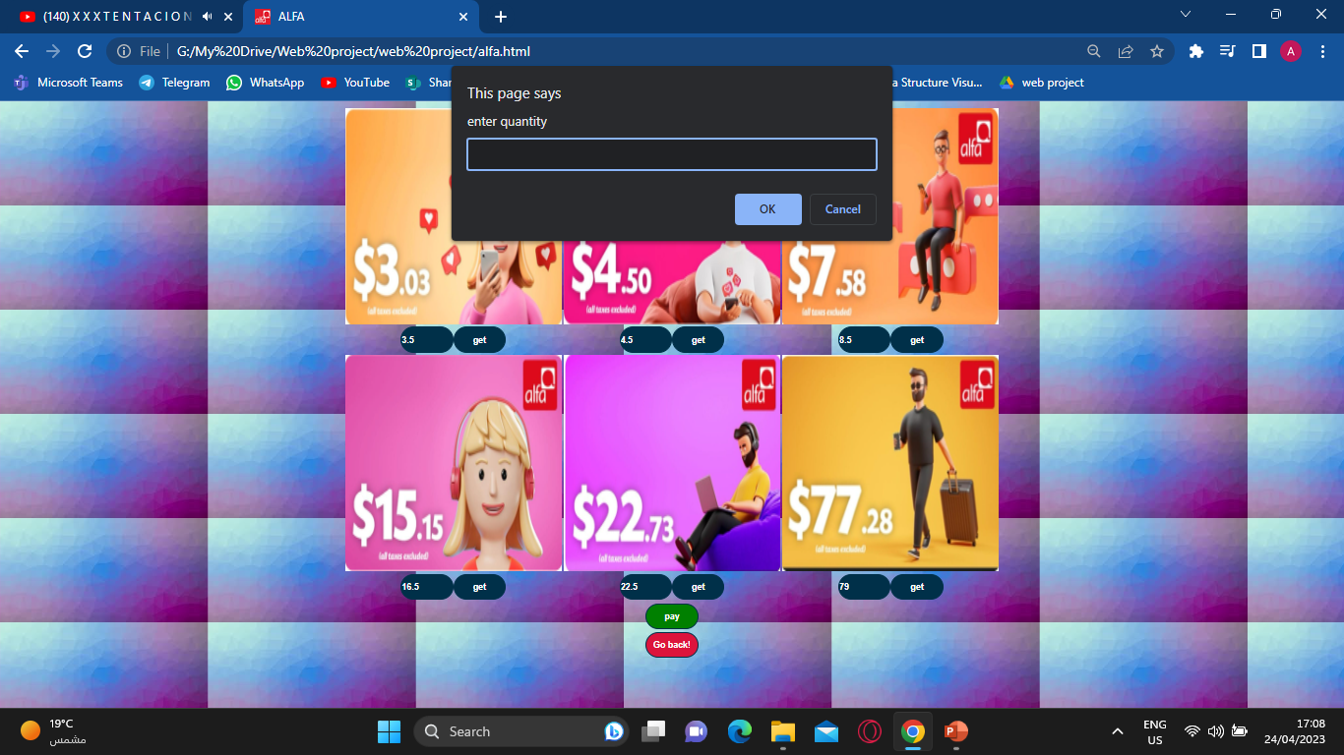
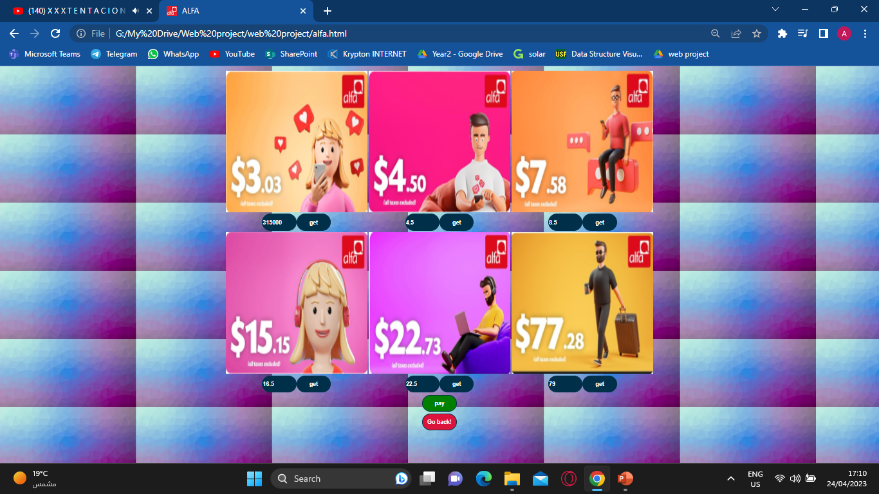
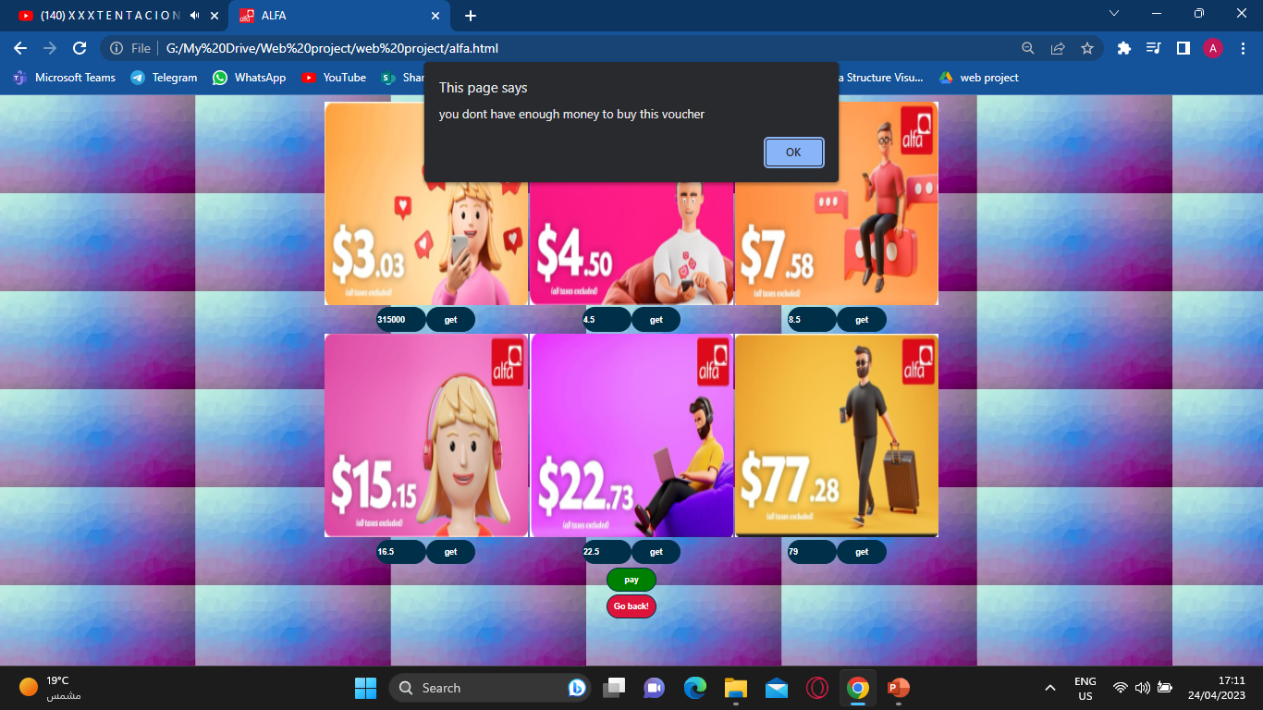
After choosing the type of voucher you want to buy, Now you can see under each voucher its price based on $, you can click on the get to add the voucher to your To Buy list, a pop up will show asking for the quantity you want to buy, after deciding how many voucher you want to buy, the price box will change to the price in L.L. ,
You can repeat this process to each voucher as long as your balance is enough.

Slide 8


You can always click on Go back! To go back to the main page!
When you click on pay , a pop up will ask to confirm the amount to be paid, after choosing OK , this amount will be deducted from your current balance.

Slide 9
The same process can be applied to all types of vouchers!

Slide 10

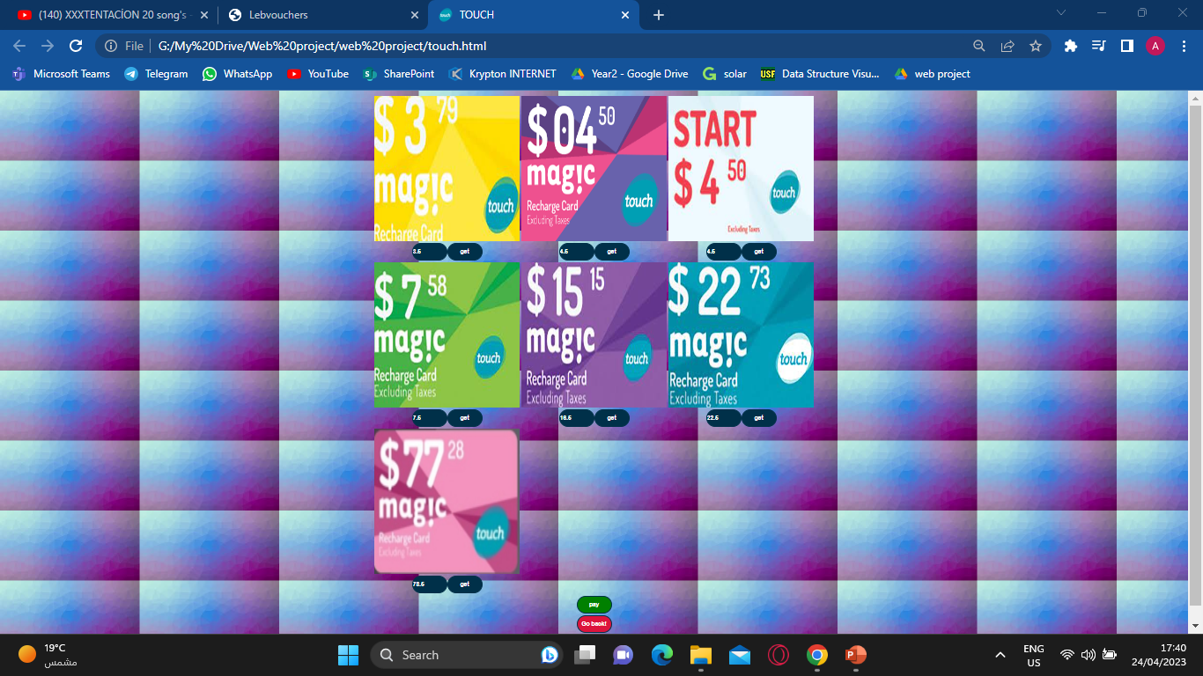

Slide 11
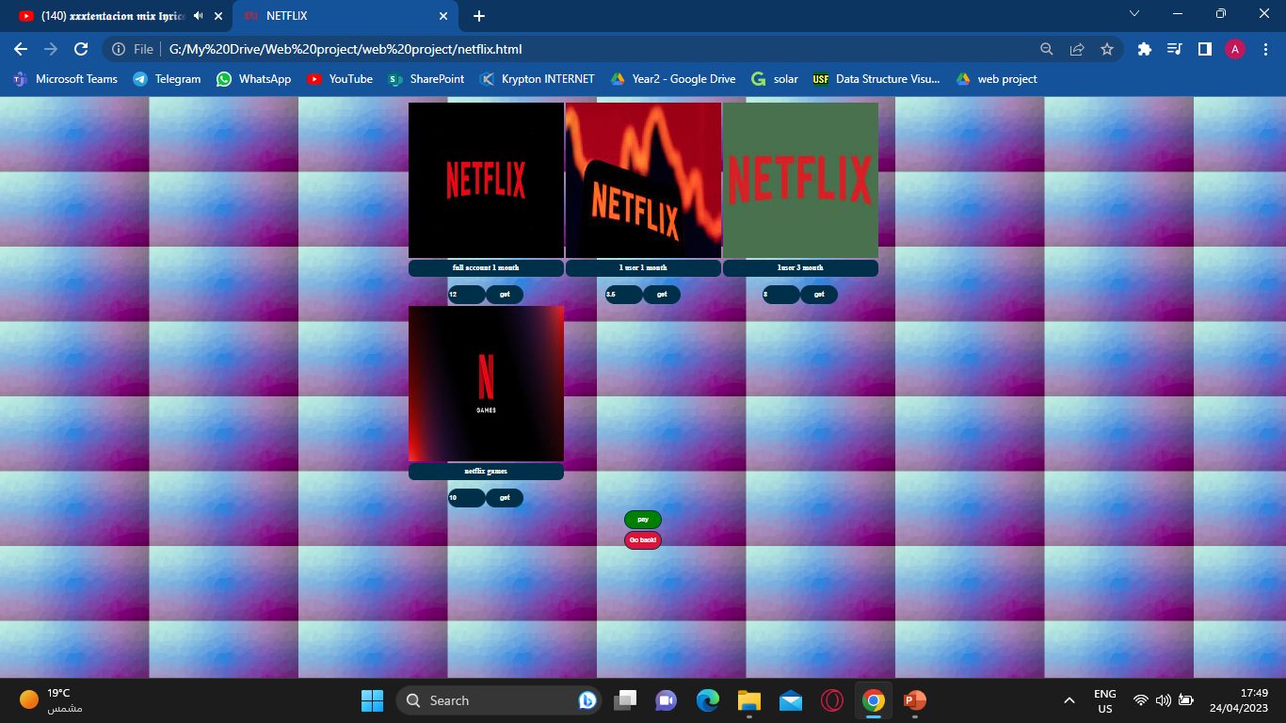
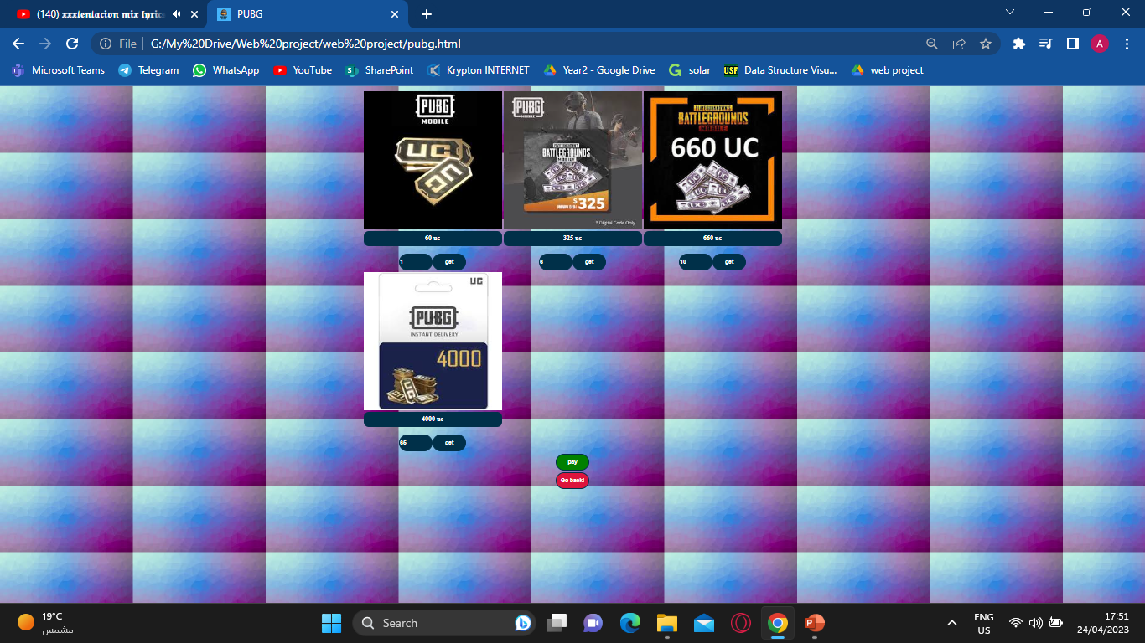

Slide 12
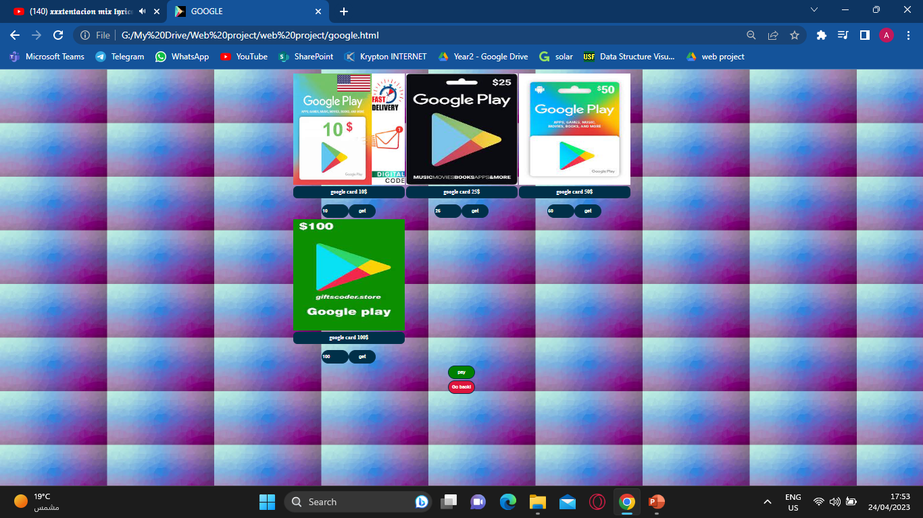
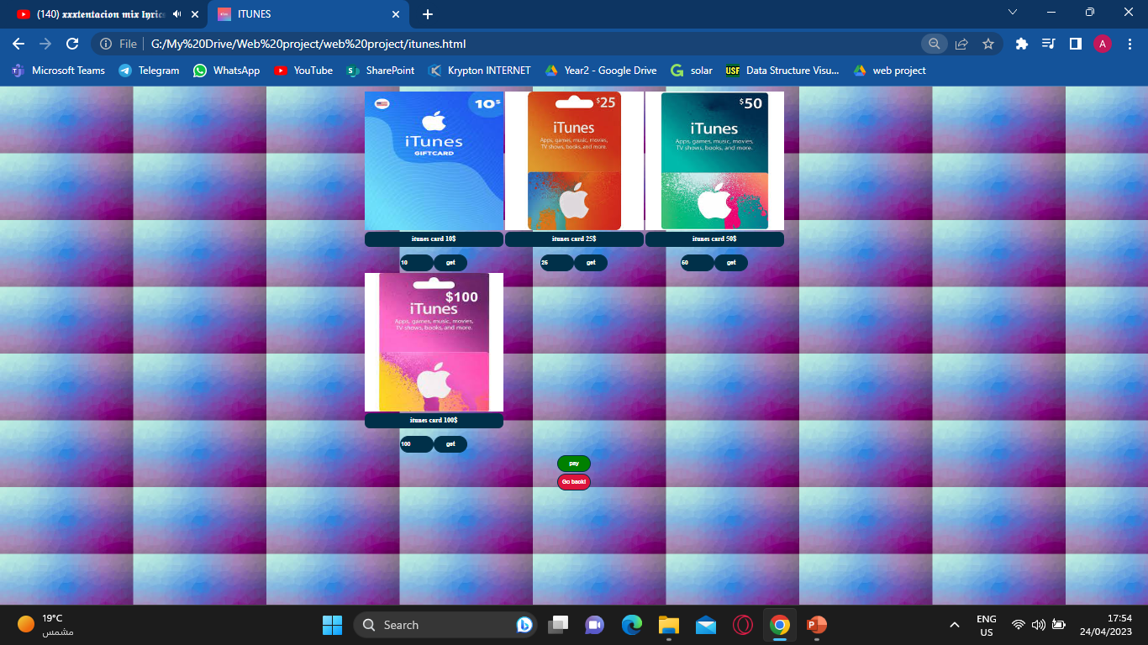

Slide 13
The URL link for the website

